Slide 2
Perfect Publications: BuckySubmit, Public Access Compliance &
Progress Reports
Ryan Schryver, Compliance Lead
Research Data, Public Access, and Digital Scholarship Services
UW-Madison Libraries
Notes:
Perfect – NOT that the publication is perfect, ie., a great publication
But that it is in compliance and can be used on a progress report.
We’re going to discuss how BS works to help bring publication into compliance, why you would want to use BS and how all of this impacts your RPPR—for the better.

Slide 3
Fast. Easy. Done.
BuckySubmit – Deposit accepted manuscripts for submission to funders’ repositories
No prior knowledge of funder submission procedures necessary
Less than 5 minutes to use
Submissions occur quickly (1-2 hours)
Emailed confirmation of submissions
Notes:
Accepted can also be VoR when authors have copyright, OA and CC
Know enough to know desired result.
Turnaround can be affected by busy periods.

Slide 4
Show & Tell
https://pas.wisc.edu/buckysubmit
What to Bring:
  Accepted manuscript – No copyright statements or journal formatting
  Exceptions: author copyrighted material/open access/creative commons
  Tables, figures, images, & supplementary information mentioned in text
  Award reference numbers
  Corresponding author = quality assurance reviewer (NIH)
  DoD liaison
Notes:
If mentioned in the text, we need it. – mostly NIHMS

Slide 5
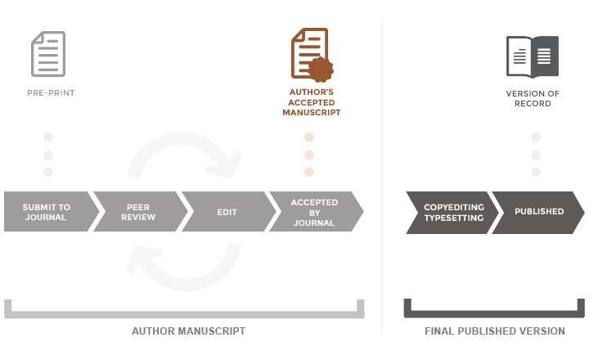
Accepted Manuscript

Slide 6
Federal Public Access to Publications Policy
Any peer-reviewed publication derived from research sponsored by PI’s award must be made publicly accessible in funder’s repository
Manuscripts must be deposited within 12 months of publication
Non-compliance may impact PI’s current or future award funding
Condition for receiving federal funds

Slide 7
Why Public Access?
Public access makes research easier to find, access and integrate
Sets the conditions for greater scientific discovery
Researchers benefit from greater exposure at no cost
Funders can better analyze R&D return on investment
The Public can see where its money is spent (transparency)
Source: “Frequently Asked Questions about the NIH Public Access Policy.” https://publicaccess.nih.gov/faq.htm.
Notes:
Why was the policy put in place? I mention this as for you the focus may be on compliance and getting the work to keep the funding in place going. For your PI, that is a primary concern, but many PI’s are also very concerned about how their work is made freely available as it reflects on them as scientists. People like to be know for their work.

Slide 8




Federal Agencies Requiring PA*
+18
*Soon All Funders
Notes:
23 federal agencies or units - $100M threshold
No DOD or USDA

Slide 9
Which publications must comply?
Peer reviewed
Published in a journal*
Papers accepted for publication on or after… *
Derived from research that received direct funding from a federal award/contract
  See: Federal Agency Public Access Requirements (pas.wisc.edu)
            * Funder determines specifics
Notes:
Juried proceedings count in some cases.

Slide 10
Direct Funding
“Costs identified specifically with a particular sponsored project, or that can be directly assigned to such activities relatively easily with a high degree of accuracy.”*
Compliance considerations (pain points)
  Collaborators
  Trainees
  Instrumentation
*Source: NIH Public Access Policy Overview, October 2024. https://sharing.nih.gov/public-access-policy/public-access-policy-overview

Slide 11
Public Access Policy Update
Nelson Memo – August 2022
Replaces optional 0–12-month embargo period with day of official publication (first online or print publication)
Impacts all federal grantmaking agencies
Policy changes in effect by end of 2025

Slide 12
DOE Compliance Basics
Effective: Awards issued or renewed after October 1, 2014
Who can submit: Authors, grantees or 3rd parties
What to submit: Accepted manuscript & metadata or versions of record may be submitted if open access or has permission
Submit to: Energy Link System (E-link)
Repository: Public Access Gateway for Energy and Science (PAGES)

Slide 13
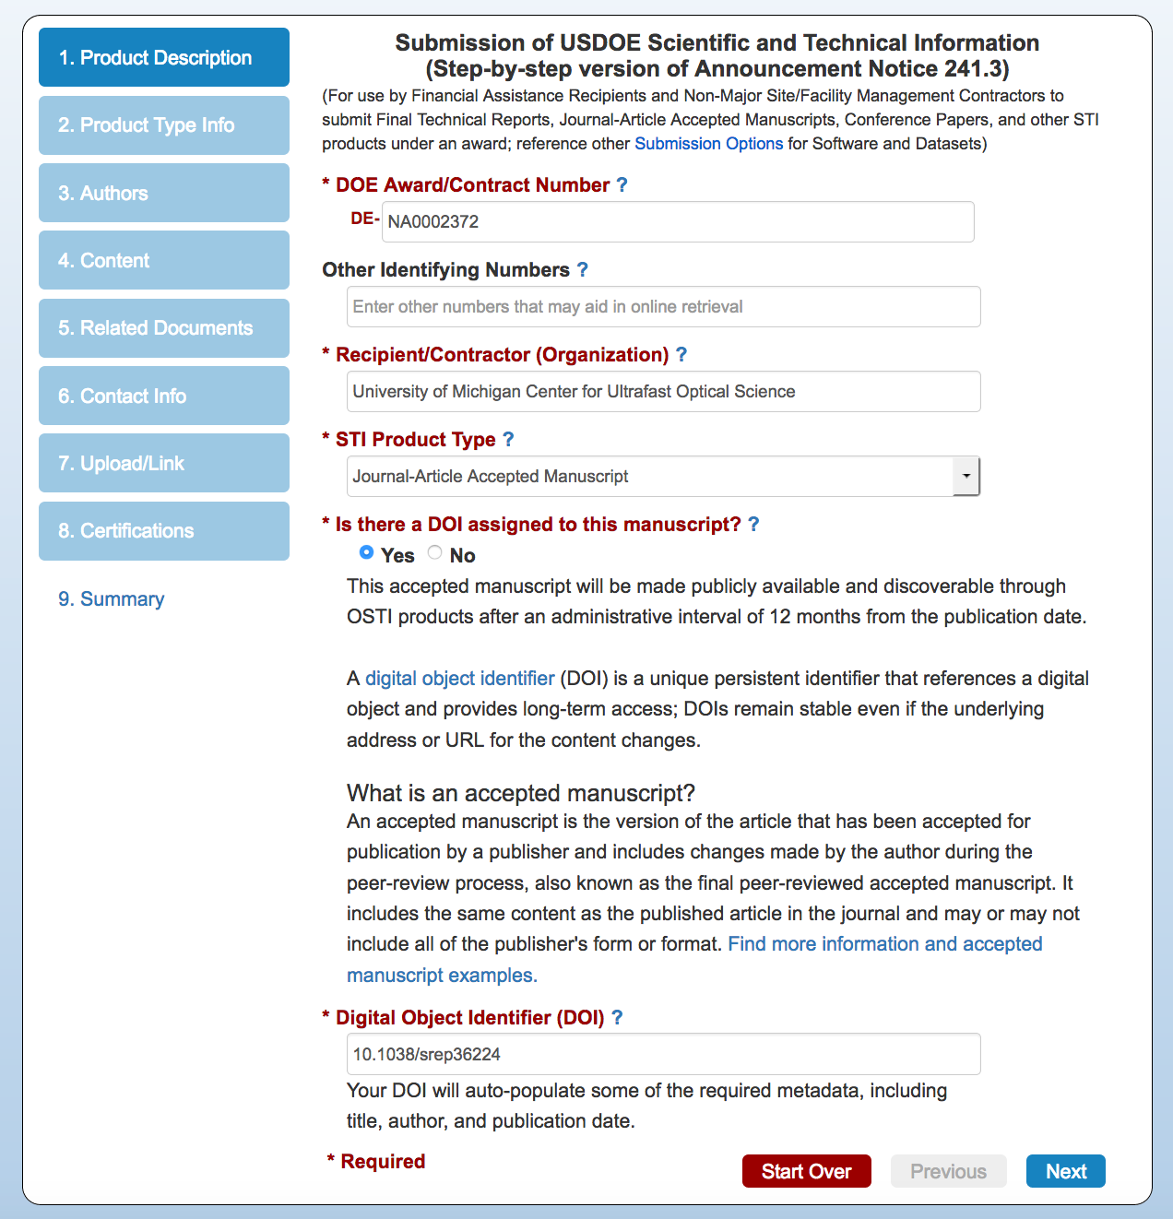
Submission Notes
Award number required
Digital Object Identifiers (DOI’s) automatically fill in journal information
If not accepted version of manuscript, use OA and/or creative commons license
Awarding offices automatically notified of submission
Compliance is based on database review.

Slide 14
NSF Compliance Basics
Effective: Publications supported by NSF grants resulting from proposals submitted or due on or after January 25, 2016
Who can submit: PI’s or co-PI’s (only)
What to submit: Accepted journal or juried conference papers. Versions of record may be submitted if open access, creative commons license or has permission
Format: PDF/A (archival)
Submit to: research.gov (award management account)
Repository: NSF Public Access Repository (NSF-PAR)
Notes:
  Works must be submitted to the NSF-PAR by the time report is submitted, or they cannot be included
  PI’s can submit manuscripts to NSF-PAR while compiling reports
  Successfully submitted manuscripts automatically appear in project reports.

Slide 15
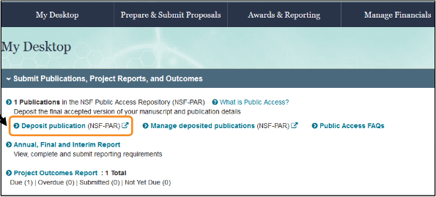
Research.gov Submission Notes
After account login, deposit and work on progress report
Use DOI to populate metadata or add manually
Add PDF/A manuscript
Confirm award
Publication will be added automatically to report within 6 hours

Slide 16
NIH/HHS Compliance Basics
Effective: Accepted for publication on or after April 7, 2008.
Timeline:
  Papers submitted within 3-months of the official publication date are considered provisionally compliant
  Papers with or without an NIHMS identification number that are 3-months past the official publication date are non-compliant until they receive a PMCID
Who can submit: Authors, PI’s or 3rd parties
What to Submit: Peer-reviewed manuscripts accepted for publication. Versions of record may be submitted if author holds copyright or has permission
Where to Submit: NIH Manuscript Submission System (NIHMS)
Public Access Repository: PubMed Central (PMC)

Slide 17


How NIH-PA Compliance Works (Ideal)
NIHMS/PubMed Central
(PMCID)
Journal/Publisher deposits
PI My Bibliography
+
RPPR (progress report)
Accepted manuscript
Authors or PI’s deposit
Establishing Compliance
Presenting Compliance
Notes:
In an ideal world…

Slide 18
NIH Public Access Terminology
PubMed
Repository where citations are often deposited by journals. PubMed inclusion by itself does not constitute compliance.
NIH Manuscript Submission System (NIHMS)
Submission portal where papers are reviewed and reformatted for deposit in PMC. Can be used by authors, PI’s or third-parties.
PubMed Central (PMC)
Full-text repository where peer-reviewed papers derived from NIH awards are deposited.
PMID
ID number given to citations added to PubMed.
NIHMSID
ID number given to papers submitted to the NIHMS.
PMCID
ID number given to article on upload to PMC. Indicates compliance with the requirement.
Represented by
Notes:
Two databases

Slide 19
NIH COMPLIANCE METHODS
Method A - Journal automatically submits published articles into PMC without author
Method B - Author prompts the journal to submit published article into PMC
Method C - Author, PI or 3rd party submits accepted paper into PMC via the NIH Manuscript Submission system (NIHMS) and designated reviewer
Method D - Publisher deposits accepted manuscript into PMC via the NIHMS and designated reviewer

Slide 20
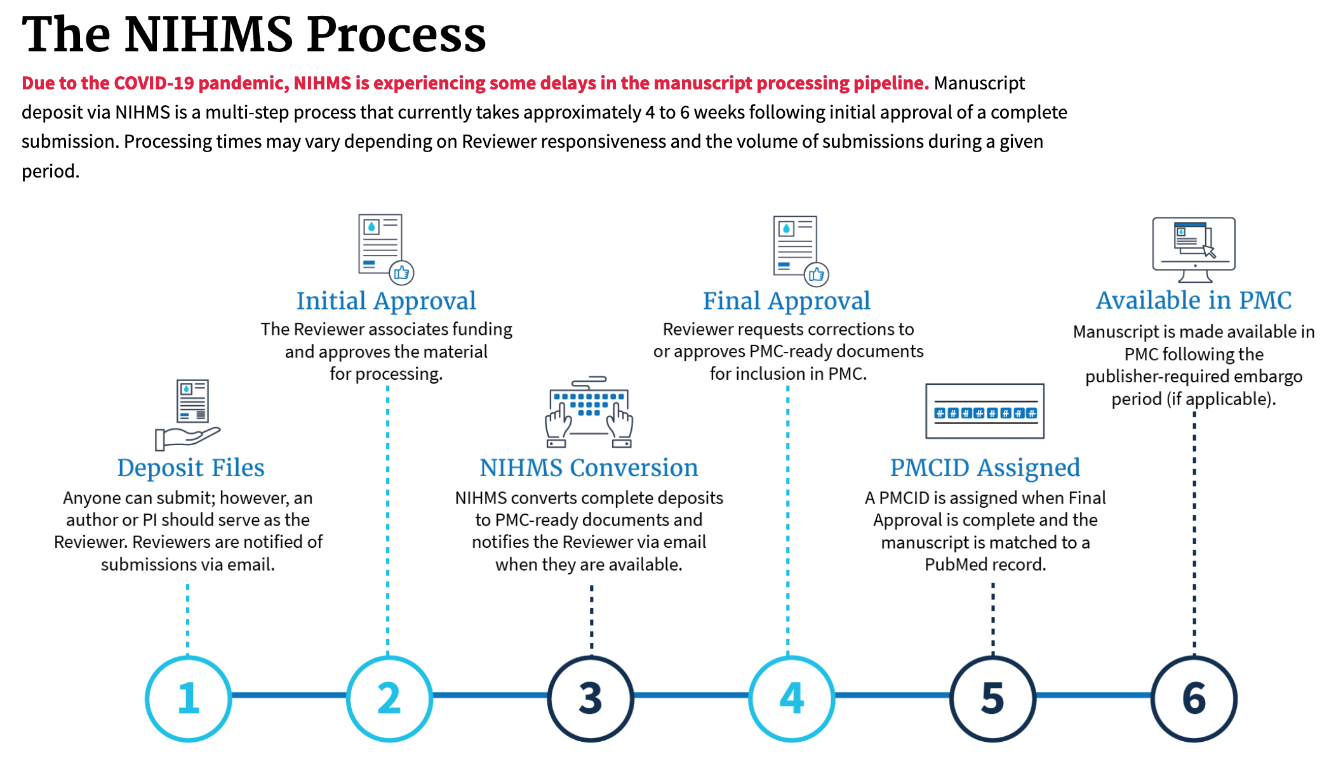
Method C Self-Submission to the NIHMS
Authors, PI’s or 3rd parties submit accepted manuscript + supplementary information to the NIHMS.
Author or associated PI is selected to be the designated reviewer.
Reviewers approves the initial submission and reformatted document before a PMCID is issued.
Notes:
Unless you add a designated reviewer to spreadsheet, I will make you the reviewer.
You will need to log into NCBI – NIH, NCBI or eRA Commons

Slide 21
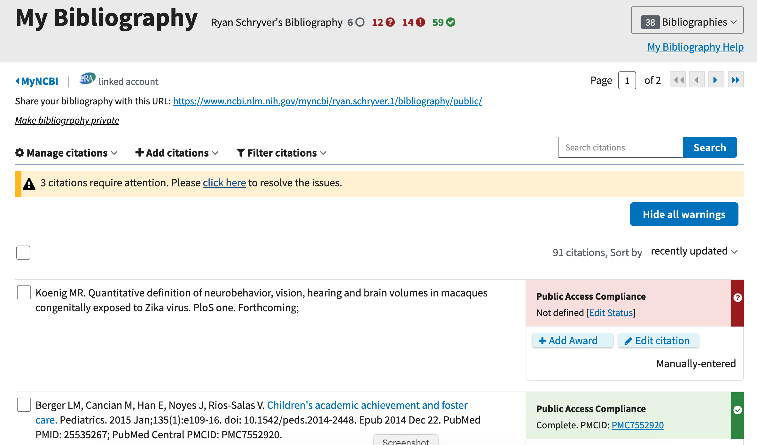
Presenting Compliance: NCBI My Bibliography
NCBI Tool
Citation list (all researchers)
Only way to add award-associated citations to RPPR (PI’s)
Provides compliance status
NCBI must be linked to eRA Commons account
Multiple accounts warning
Notes:
Btw, if you are not familiar with My Bibliography

Slide 22
NIH RPPR Tips – Section C1, Products
DO associate awards with citation on NCBI My Bibliography
DO NOT submit noncompliant publications – Stalled review
  Proof of Compliance (PDF Report on My Bibliography)
  PRAM + Signing Official
  Direct to NIH via email
STOP seeing double = MPI awards + multiple My Bibliography associations
DO NOT select noncompliant publications - lock potential
DO think about the future – Noncompliant FPPR’s cause application issues

Slide 23
PAS Compliance Services
Fast. Easy. Done.
MyBib Check-up
Custom Compliance Reports
BuckySubmit

Slide 24
The PARTNERS Solution (Free!)
Online and in-person compliance training
Regular tailored compliance reports
NCBI My Bibliography assistance
Targeted literature searches
NIHMS submission assistance (one folder)
Notes:
This is how we make public access compliance easier for you and keep publications RPPR-ready year-round. We can tailor these to specific units' needs and timelines. All services are free. (1 min)

Slide 25

UW-Madison Public Access Service
Ryan Schryver, Compliance Lead
https://pas.wisc.edu
publicaccess@wisc.edu

Slide 26
Questions?

